Slide 1
SMART HOME AUTOMATION – WATER MOTOR CONTROLLER
Submitted by,
SHIVANI MANGALESWARAN
Computer Science and Engineering
Under the guidance of,
Dr . S. VIGNESHWARI, M.E., Ph.D.,

Slide 2
ABSTRACT
The Internet of Things is a ubiquitous technological advancement, enabling intelligent Machine to Machine interaction over compatible networks.
An emerging application of IoT is smart home automation. This project aims to address environmental conservation through smart resource management.
Automation of water motors can prevent overflow and unnecessary wastage of water.
The project has been designed to turn a motor ON or OFF automatically through Raspberry Pi, HCSR-04 ultrasonic sensor and Java Micro Edition 8.3 platform.

Slide 3
PROBLEM DEFINITION
Precious water is wasted every day in Indian households and commercial establishments when water overflows in overhead tanks, before it is manually switched OFF.
The project aims to solve this issue through IoT by automating the water motor, thereby preventing wastage.

Slide 4
TECHNICAL PROBLEM STATEMENT
The Internet of Things has been employed to address the problem defined in the previous slide.
This is achieved through real time monitoring of overhead tanks. Based on the water level, a motor is designed to go ON/OFF automatically before possibility of overflow.
The tank must also never run dry, provided there is constant water supply.
This main aim of this project is to achieve judicious resource management.

Slide 5
LITERATURE REVIEW
A literature survey conducted on Smart Cities has been presented as a paper entitled “A Survey on Implementation of Internet of Things to Develop Smart Cities” in ICAFM 2017, which is slated for publication. The full-length paper, a copy of the abstract as published in the conference proceedings book and the certificate of participation have been attached as proof in the appendix of the documentation.

Slide 6
LITERATURE REVIEW
The paper published by PUB, Singapore entitled “Public Utilities Board Singapore Smart Water (2016) 1: 4. doi:10.1186/s40713-016-0004-4”, Springer, provided an insight into the current scenario of real time-water supply monitoring through IoT in a smart city.
The Public Utilities Board of Singapore provides clean water 24 hours a day, 7 days a week through the implementation of an IoT based Smart Water Grid.
As defined by PUB , “A Smart Water Grid system integrates Information and Communications Technologies (ICT) into the management of the water distribution system. Sensors, meters, digital controls and analytic tools are used to automate, monitor and control the transmission and distribution of water, ensuring that water is efficiently delivered only when and where it is needed and with good quality.”
Monitoring pipeline conditions, pressure, quality and assessing water consumption information are done in real time, increasing the efficiency of preventive maintenance, planning and water conservation.

Slide 7
LITERATURE REVIEW
The survey threw light on the sensors used by PUB for maintenance of the Smart Water Grid. Three broad classification of sensors were identified:
i)Acoustic sensors based on accelerometers
ii)Acoustic sensors based on hydrophone sensors
iii)High rate pressure sensors
The acoustic sensors are used to capture sound waves in water to detect leaks in pipes.
This inspired the idea of using an ultrasonic sensor which uses ultrasonic sound waves to detect the distances of objects, in the case of this project, the level of water.

Slide 8
REQUIREMENTS
HARDWARE
RASPBERRY PI MICROCOMPUTER
HC-SR04 ULTRASONIC SENSOR
SOFTWARE
RASPBIAN JESSIE WITH PIXEL OPERATING SYSTEM(LINUX-BASED)
Win32Disk Imager
7-zip file manager for Windows (WinRAR incompatible)
NetBeans IDE 8.1
JAVA ME 8.3
PuTTY
PSFTP

Slide 9

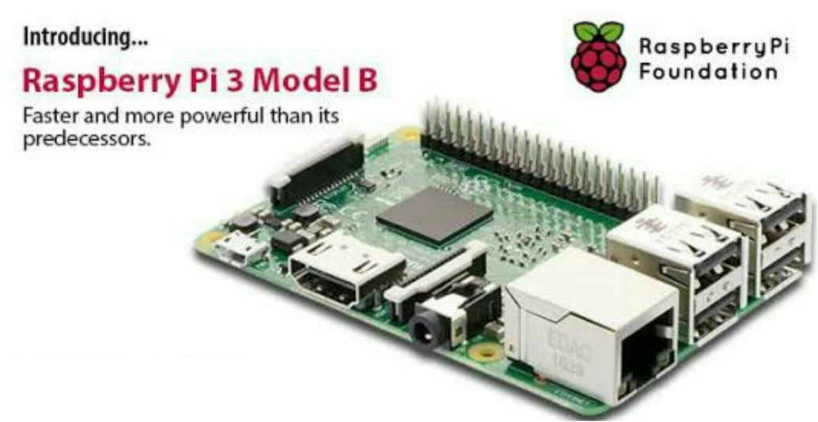
REQUIREMENTS - HARDWARE
RASPBERRY PI 3 MODEL B

Slide 10
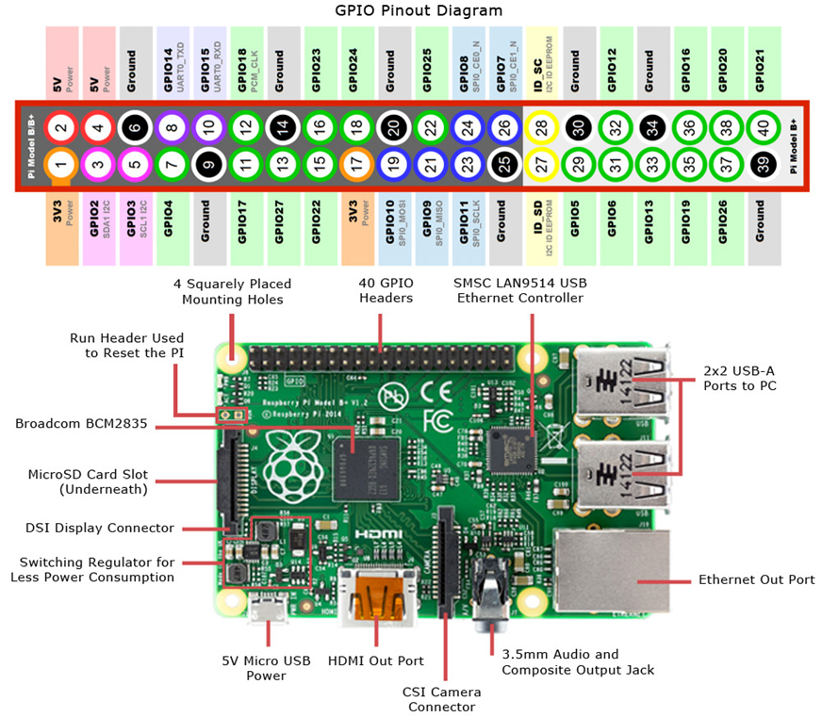
PARTS OF A RASPBERRY PI

Slide 11
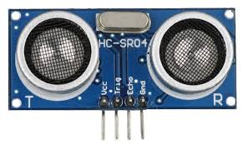
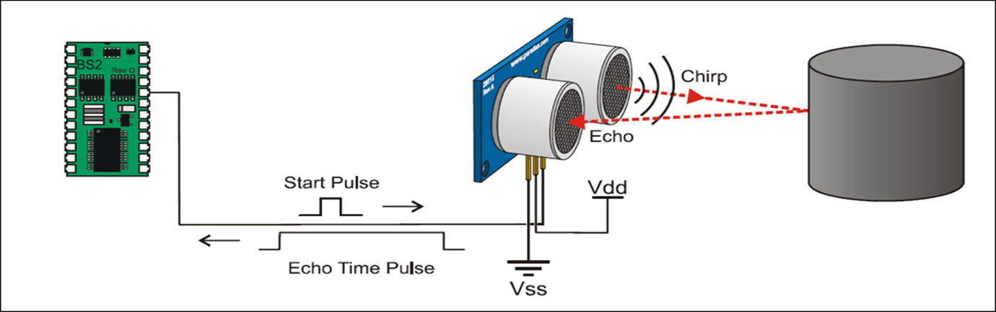
HC-SR04 ULTRASONIC SENSOR
TRIGGER -> INPUT (FROM PI)
ECHO->(OUTPUT TO PI)
Table : HC-SR04 PIN CONFIGURATION
S.No | PIN | DESCRIPTION
1. | Vcc | Connects to 5V positive voltage for power.
2. | TRIG | Triggers the sensor to send eight 40khz for object detection.
3. | ECHO | This pin is low (0V) until an object has been detected and goes high (5V) on detection.
4. | GND | Completes electrical pathway of power supply.

Slide 12
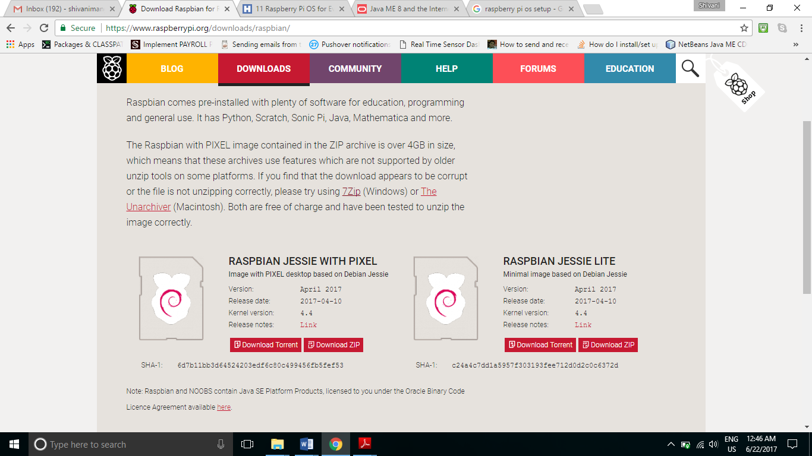
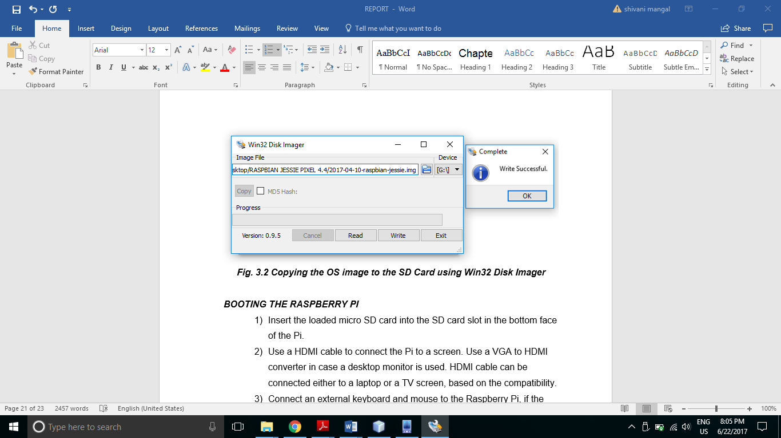
SOFTWARE REQUIREMENTS – OS INSTALLATION

Slide 13
GRANTING SSH ACCESS
SSH must be enabled to allow the local host system that runs Java ME 8.3 code to gain access to the Raspberry Pi via its static IP

Slide 14
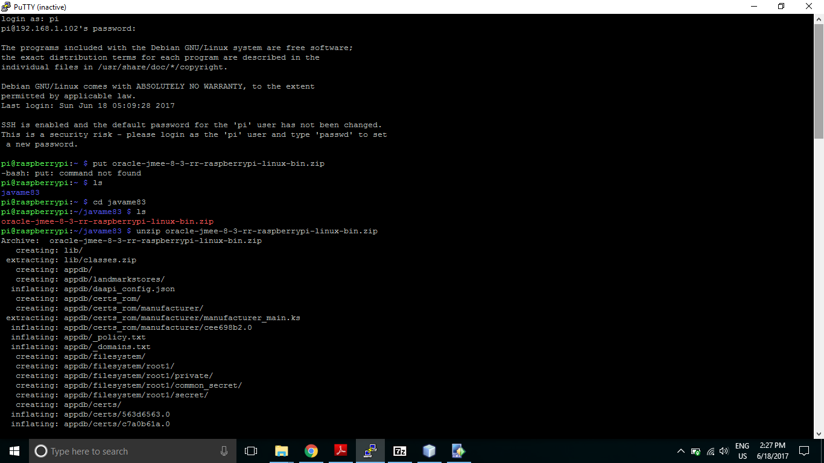
JAVA ME 8.3 TRANSFER FROM LOCAL HOST TO PI
1. Start PuTTY on the local host machine.
2. Obtain the IP address of the Pi using ifconfig in the Pi’s terminal.
3. Use the IP retrieved to access the pi via “open ip_address” command on the local host.

Slide 15
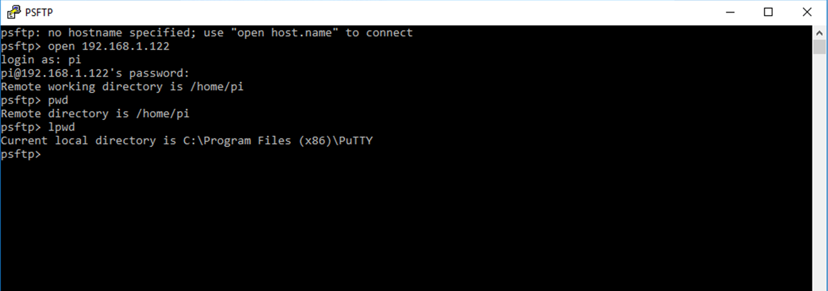
PSFTP COMMANDS

Slide 16
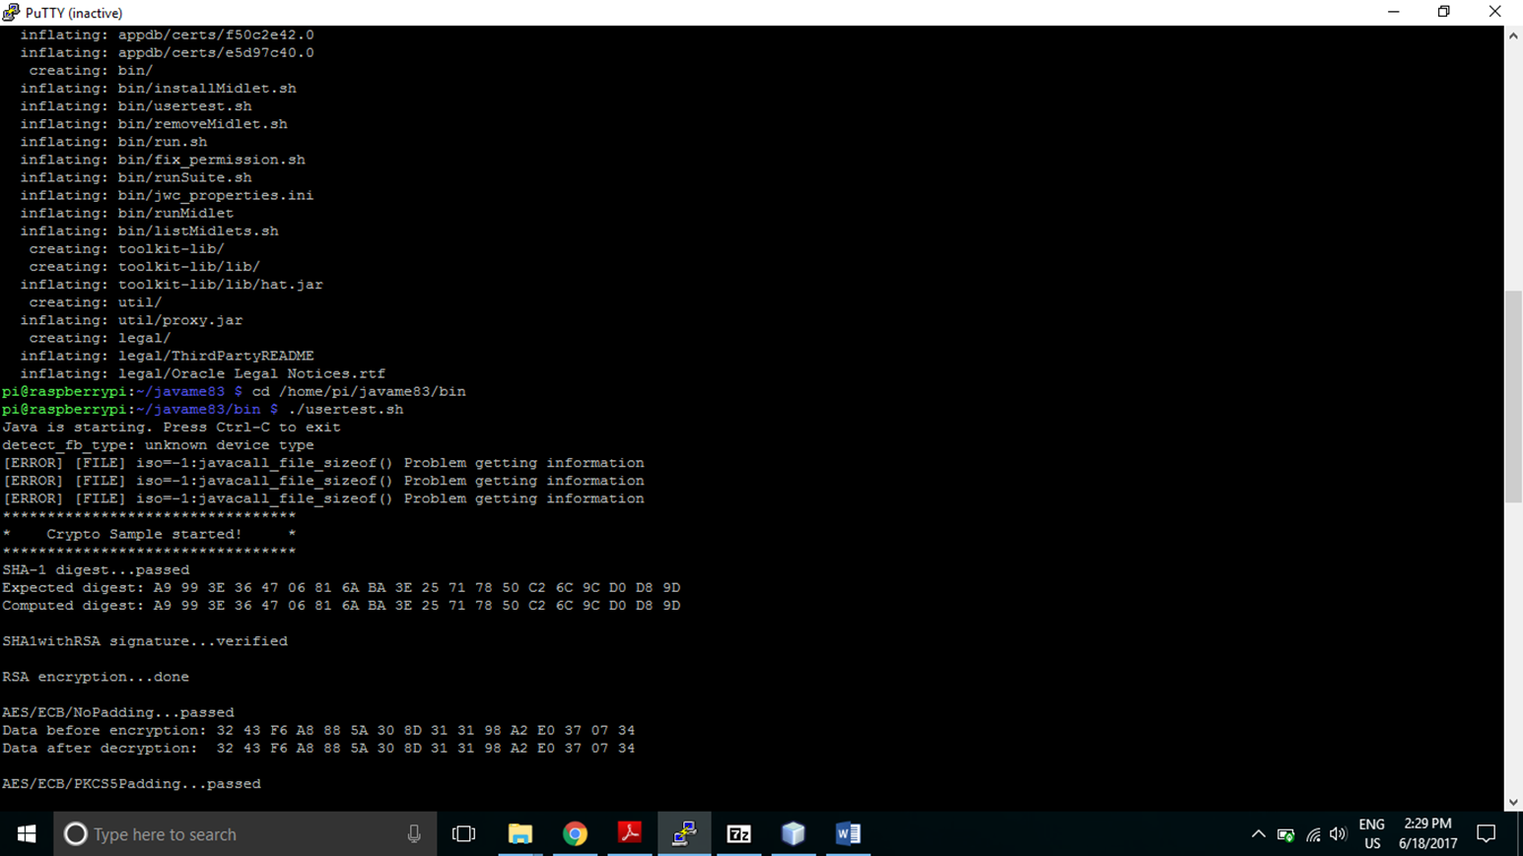
RUNNING A SAMPLE PROGRAM ON THE PI
Navigate into the javame83 folder created, where Java ME 8.3 was transferred to, and run AMS as the root user.
Running usertest.sh script without “sudo”, may result in the denial of access to GPIO pins.

Slide 17
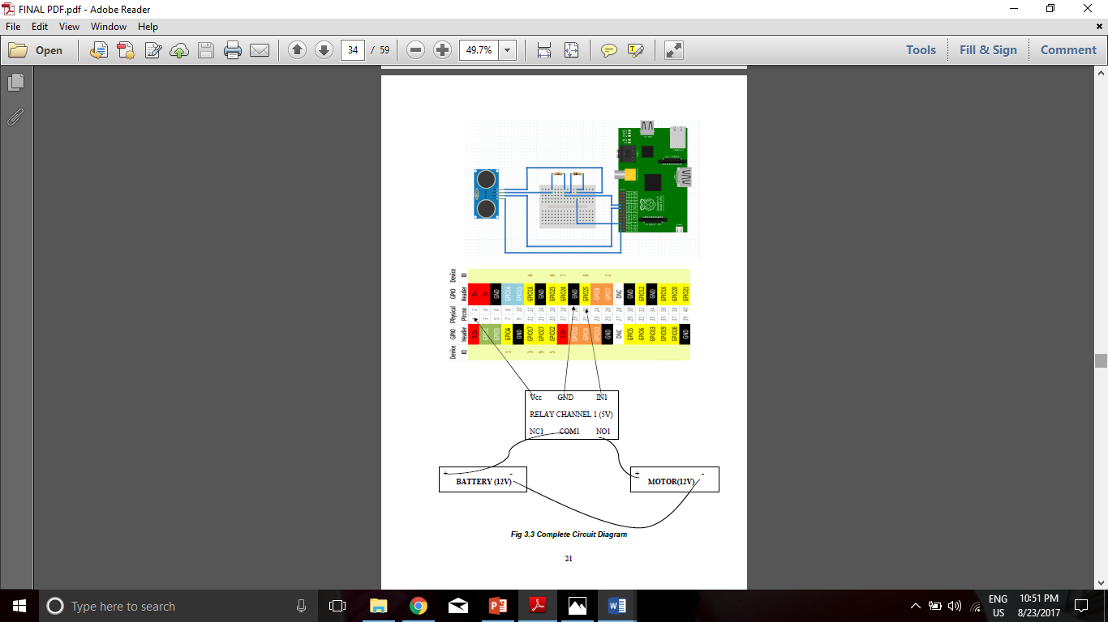
CIRCUIT DIAGRAM

Slide 18
Experimental Set Up

Slide 19
Motor - ON state indicated by glowing LED

Slide 20
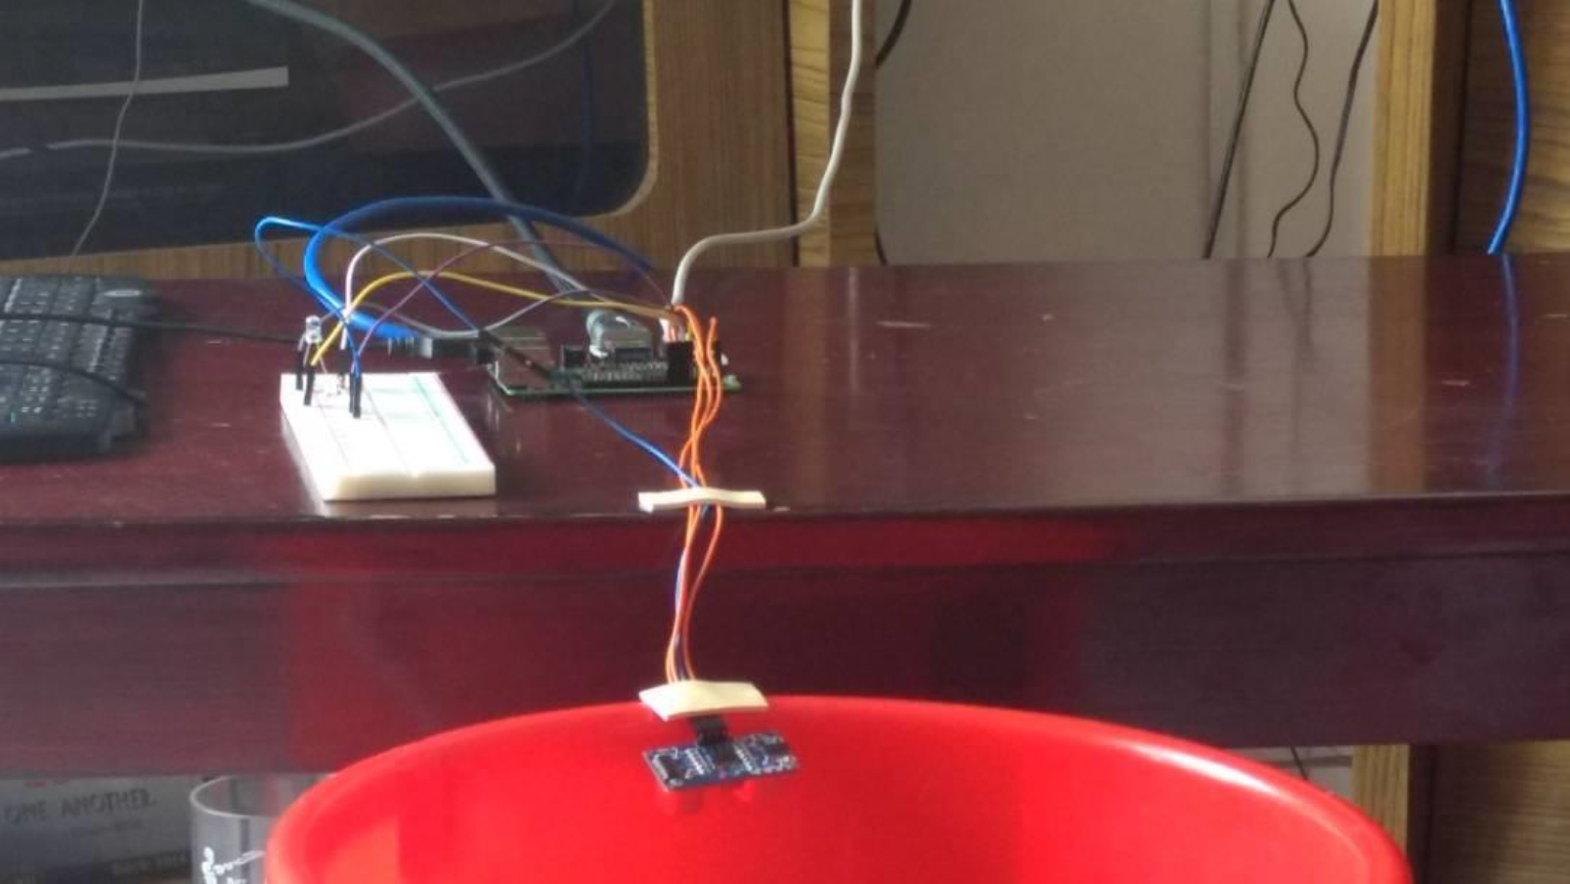
Sensor mounted on the bucket

Slide 21
Overview of inlet and outlet water sources of the motor

Slide 22
BLOCK DIAGRAM OF SYSTEM IMPLEMENTATION AND EXECUTION
Install Raspbian Jessie Pixel OS. Copy it to a micro SD Card. Boot the Raspberry Pi with the SD Card.
Connect HC-SR04 Ultrasonic sensor, voltage regulator, relay channel switch, motor and battery to the Raspberry Pi carefully, using circuit diagrams.
Use SSH to login to the Pi. Manage device connections in Netbeans. Check for proper platform and API permissions in Java Me 8.3 SDK platform.
Move into bin folder of Java 8.3 in the Pi and start AMS.
View the output on the emulator and the Raspberry Pi terminal.

Slide 23
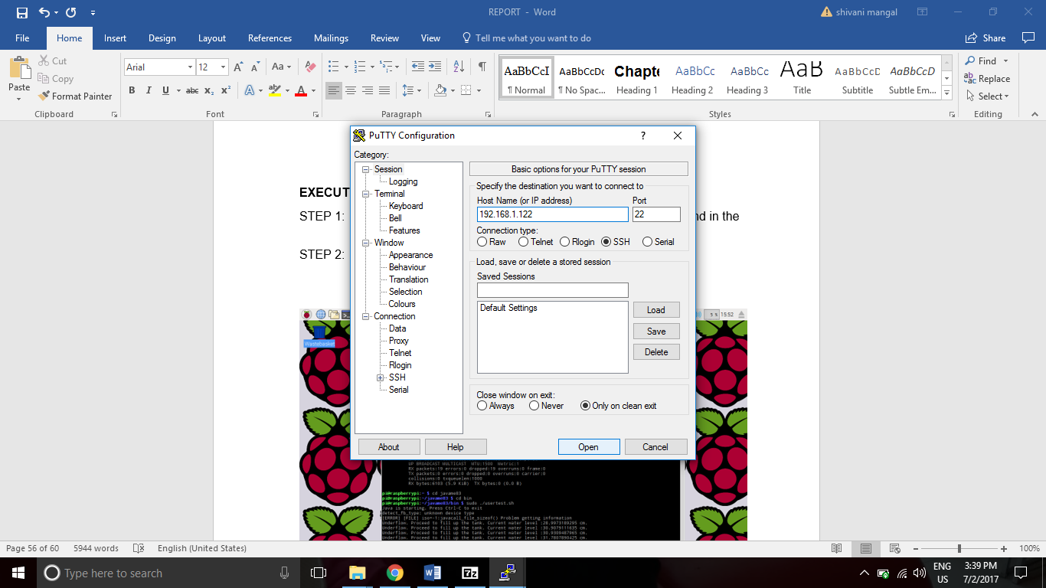
STEPS FOR EXECUTION
STEP 1: Enable SSH on the Raspberry Pi and enter ifconfig command in the terminal to determine the static ethernet IP address.
STEP 2: Open PuTTY on the local host machine and enter the IP address of the Raspberry Pi. Select SSH as the connection type and open as depicted below.

Slide 24
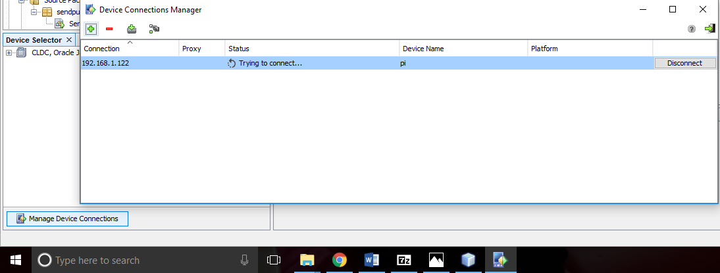
STEPS FOR EXECUTION
STEP 3: In the Raspberry Pi’s terminal, move into the bin folder of Java ME 8.3 which has been installed through PSFTP.
STEP 4:Start AMS as the root user through the command “sudo ./usertest.sh”. This starts Java on the Pi.
STEP 5: In the local host system, open NetBeans. Open the project BucketMotor. Select Manage Device Connections in the bottom left corner and add device. Enter the IP address of the Raspberry Pi and connect to the Pi.
STEP 6: Right click on project BucketMotor. Select Properties and go to Platform. Manage Java ME Platforms and add Oracle Java(TM) Platform Micro Edition SDK 8.3. Select “Pi” (Name of the Raspberry Pi) under devices as depicted here.

Slide 25
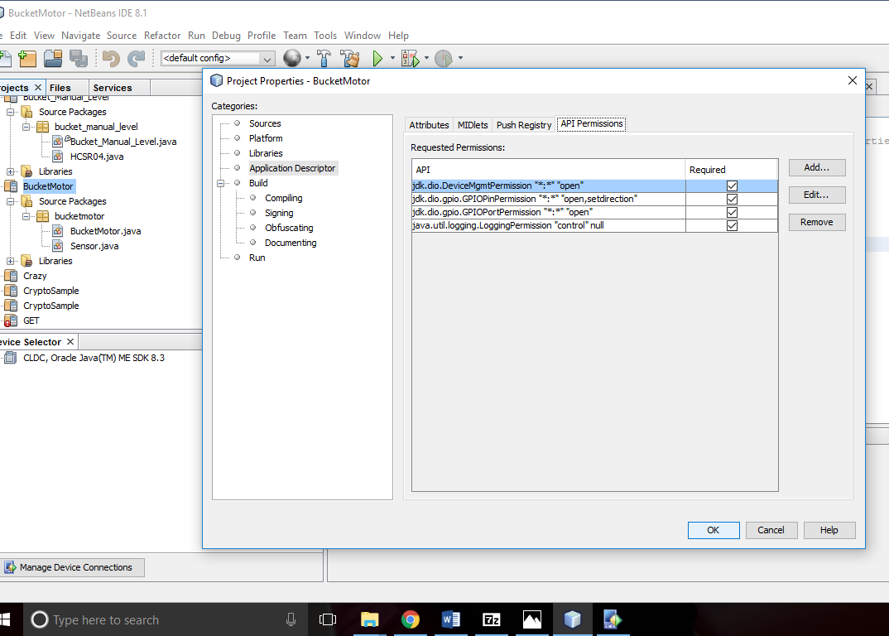
STEPS FOR EXECUTION
STEP 7: Go to Application Descriptors and add necessary API Permissions
STEP 8: Click Run to start the program. The output can be viewed simultaneously on the emulator on the local host and the terminal on the Raspberry Pi.
STEP 9: In case the bucket is empty, pour some water to eliminate the underflow condition. The goal of this program is to never permit the tank to reach an underflow condition, as long as there is a constant supply of water to the inlet of the motor. The motor continues to fill up the bucket until the overflow condition is reached, then the motor goes OFF.
STEP 10: Stop the program. Review the output.

Slide 26
RESULTS AND DISCUSSIONS
OUTPUT ON THE RASPBERRY PI TERMINAL (1)

Slide 27
RESULTS
OUTPUT ON THE RASPBERRY PI TERMINAL (2)

Slide 28
RESULTS
OUTPUT ON THE RASPBERRY PI TERMINAL (3)

Slide 29
RESULTS
OUTPUT ON THE RASPBERRY PI TERMINAL (4)

Slide 30
RESULTS
OUTPUT ON THE LOCAL HOST EMULATOR (1)

Slide 31
RESULTS
OUTPUT ON THE LOCAL HOST EMULATOR (2)

Slide 32
RESULTS
OUTPUT ON THE LOCAL HOST EMULATOR (3)

Slide 33
REFERNENCES
Andrea Zanella, Nicola Bui, Angela Castellani, Lorenzo Vangelista, Michele Zorzi, Internet of Things for Smart Cities, IEEE Internet of Things Journal (J-IOT) , 2014
Luigi Atzori, Antonio Iera, Giacomo Morabito, The Internet of Things: A survey, Comput. Netw. (2010), doi:10.1016/ j.comnet.2010.05.010, Elsevier
Public Utilities Board Singapore Smart Water (2016) 1: 4. doi:10.1186/s40713-016-0004-4, Springer
Tara Salman, Raj Jain, Internet of Things Protocols and Standards, http://www.cse.wustl.edu/~jain/cse570-15/ftp/iot_prot/index.html
Wang N., Wu W. (2012) The Architecture Analysis of Internet of Things. In: Li D., Chen Y. (eds) Computer and Computing Technologies in Agriculture V. CCTA 2011. IFIP Advances in Information and Communication Technology, vol 368. Springer, Berlin, Heidelberg

Slide 34
REFERNENCES
An introduction to GPIO and physical computing on the Raspberry Pi https://www.raspberrypi.org/documentation/usage/gpio/ Last accessed on 19th July 2017.
Arduino water level controller using HC-SR04 https://www.youtube.com/watch?v=-tuTQ2e9_Qg&t=131s Last accessed on 19th July 2017.
CLDC.http://docs.oracle.com/javame/config/cldc/opt-pkgs/api/cldc/api/index.html Last accessed on 19th July 2017.
Developing Java ME Applications https://docs.oracle.com/cd/E50453_01/doc.80/e50452/dev_jme_apps.htm Last accessed on 19th July 2017.
How to build an HC-SR04 Distance Sensor Circuit http://www.learningaboutelectronics.com/Articles/HC-SR04-ultrasonic-distance-sensor-circuit.php Last accessed on 19th July 2017.
Interface GPIO Pin http://docs.oracle.com/javame/config/cldc/opt-pkgs/api/daapi-3.4/com/oracle/deviceaccess/gpio/GPIOPin.html Last accessed on 19th July 2017.

Slide 35
REFERNENCES
Package java.util.logging description https://docs.oracle.com/javase/7/docs/api/java/util/logging/package-summary.html#package_description Last accessed on 19th July 2017.
Simple Water Level Controller https://www.youtube.com/watch?v=RTmbWMSiwiQ&t=78s Last accessed on 19th July 2017.
The MagPi – A Magazine for Raspberry Pi Users ISSUE 27 – OCT 2014 Pages 15,18– 21 (https://www.raspberrypi.org/magpi-issues/MagPi27.pdf) Last accessed on 19th July 2017.
Water Pump Control using Raspberry Pi https://www.youtube.com/watch?v=lRI4Z-Pe7Qc Last accessed on 19th July 2017.
www.youtube.com/watch?v=nKA2TE3_sS4 Last accessed on 19th July 2017.

